Slide 1
Elder opens with a prayer. Assign family groups and issue family cards. Each family must have children.
Issue 2 money, 3 food and 4 health resource cards to each group.
Issue visuals and a glossary for each group.
Invite groups to move to the first station after doing family introductions.
Notes:
There must be a balance of children, babies, parents, grand parents, uncles and aunts.

Slide 2
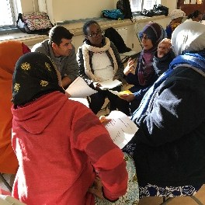
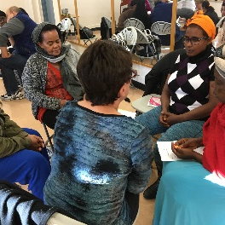
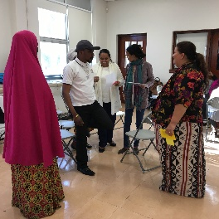
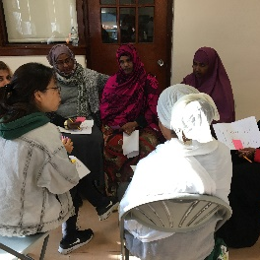
Group receives a location card and a choice card at the European Contact Location. They read and discuss as a family.
Groups takes back the choice card to the European Contact Location. They report on the choice they have made and receive an option card.
Group pays what is due at the European Contact Location as it is written on their option card. They can negotiate as needed.
Group sits down at the European Contact Location to discuss the reflection questions posted at the location.
Notes:
Up to a maximum of two groups will be allowed to not make treaties with the Europeans.

Slide 3
Group receives a location card and a choice card at the Fur Trade Location. They read and discuss as a family.
Groups takes back the choice card to the Fur Trade Location. They report on the choice they have made and receive an option card.
Group pays what is due at the Fur Trade Location as it is written on their option card. They can negotiate as needed.
Group sits down at the Fur Trade Location to discuss the reflection questions posted at the location.
Notes:
Tools resource cards will be assigned at this location.

Slide 4
Group receives a location card and a choice card at the Avoided Contact Location. They read and discuss as a family.
Groups takes back the choice card to the Avoided Contact Location. They report on the choice they have made and receive an option card.
Group pays what is due at the Avoided Contact Location as it is written on their option card. They can negotiate as needed.
Group sits down at the Avoided Contact Location to discuss the reflection questions posted at the location.
Notes:
Only one group can go into hiding as there were not many families that managed to do this. If the group hides closer to the community they will get 1 tool resource card.

Slide 5
Group receives a location card and a choice card at the Residential School Location. They read and discuss as a family.
Groups takes back the choice card to the Residential School Location. They report on the choice they have made and receive an option card.
Group pays what is due at the Residential School Location as it is written on their option card. They can negotiate as needed.
Group sits down at the Residential School Location to discuss the reflection questions posted at the location.
Notes:
Children in the family will be taken away at this location.

Slide 6
Group receives a location card and a choice card at the Reserve System Location. They read and discuss as a family.
Groups takes back the choice card to the Reserve System Location. They report on the choice they have made and receive an option card.
Group pays what is due at the Reserve System Location as it is written on their option card. They can negotiate as needed.
Group sits down at the Reserve System Location to discuss the reflection questions posted at the location.
Notes:
Tools resource card will be taken away at this location as hunting is restricted.

Slide 7
Group receives a location card and a choice card at the Migration Location. They read and discuss as a family.
Groups takes back the choice card to the Migration Location. They report on the choice they have made and receive an option card.
Group pays what is due at the Migration Location as it is written on their option card. They can negotiate as needed.
Group sits down at the Migration Location to discuss the reflection questions posted at the location.
Notes:
Groups will be encouraged to reflect on their experiences moving to Canada and relate with those of First Nations families moving from the reserve.

Slide 8
Groups debrief together or as a larger group
Question and answer period
Elder closes with a prayer
Volunteers collect all of the materials

