Slide 1
The Action Coalition on Human Trafficking, Alberta
Notes:
Hello, thank you for joining us today. First and foremost, I would like to thank ….for your strength and courage sharing your story with us. Today I will present you with a brief overview of the what the organization is seeing in terms of referrals and cases, current projects of ACT Alberta aimed at addressing challenges to responding to human trafficking in the province, and recent developments or initiatives that will have an impact on the response.

Slide 2
Our Mission
ACT Alberta will increase knowledge and awareness on human trafficking, advocate for effective rights-based responses, build capacity of all involved stakeholders, and lead and foster collaboration for joint action against human trafficking.
Notes:
ACT Alberta is a coalition working to identify and respond to human trafficking in Alberta.
Our Mission: to increase knowledge and awareness on human trafficking, advocate for effective rights based responses, build capacity of all involved stakeholders, and lead and foster collaboration for joint action against human trafficking
The ACT Project was housed within Changing Together - a Centre for Immigrant Women located in Edmonton. A 2007 Environmental Scan called “Trafficking of Women and Girls to Canada” found trafficking to be inadequately addressed, and so ACT Alberta was formally founded as a not-for profit agency, and an officially registered charity 2010. As of this time, we currently have offices residing in Edmonton and Calgary.
Our Values
Human rights-based and victim-centered
Collaboration
Diversity
Evidence-based
ACT Alberta uses a human rights based lens because:
Relying solely on Criminal Justice definitions in our legislation may overlook some victims (i.e. victims who have been involved in or forced into criminal activity)
Using a human rights lens keeps the victim in the center of all processes all the time
Many victims may not know their rights, this is what traffickers take advantage of
Victims of trafficking especially need their rights protected in the service provision – right to privacy, the right to say no to certain services, the right to return home (wherever that may be).

Slide 3
Types of Trafficking
Cases included are those with significant elements of human trafficking, and are based on all of ACT Alberta's referrals since 2008.
Notes:
The statistics you’ll see today reflect only ACT Alberta’s referrals. Disclaime: use of victim throughout the presentation, due to the fact that our funding is largely through the Victims of Crime Fund and our mandate is to support individuals who have been referred to ACT as victims. In addition, we assist individuals in accessing services that meet the needs of victims of trafficking.
57.9% of the people we have worked with are domestic VTIPs or Canadian citizens.
There is a disproportionate representation of Indigenous women and girls
- 41.6% of our clients we’ve found to be TFW or international victims of HT (e.g. visitors).
- The remaining .5% are combined cases of internal and international trafficking.
The average age ACT Alberta is assisting for females is 26 and males is 28. For right now, we only work with 18+ clients however this doesn’t mean we wouldn’t be making appropriate referrals to the stakeholders we currently work with who would be able to assist those in need at any age under the Protection of Sexually Exploited Children’s Act (PSECA).

Slide 4
ACT Alberta Cases and Trends
Cases included are those with significant elements of human trafficking, and are based on all of ACT Alberta's referrals in 2018.
Notes:
Human Trafficking in Alberta. There is no stereotypical victim. Everyone’s story is different. However, some common threads. “Other” is victims not meeting the UN Protocol and we still help support them.

Slide 5
Gender
Notes:
We are seeing an increase in transgender women experiencing trafficking – in part due to chronic and episodic homelessness this makes them more vulnerable.

Slide 6
What We Do
Coordinate and provide services to victims
Training and Education
Strategic Engagement
Partners
Notes:
Our Victim Response Program has a coordinator in Edmonton and Calgary, who provide case management and coordinate services for victims of human trafficking. These units work in close collaboration with law enforcement, including, CBSA, RCMP, local authorities (e.g. body rub task force) and Government agencies like Employment standards, IRCC
Train and educate service providers
Engage and educate the public
3. Conduct research and collection of data on human trafficking – CAP report, with 3 new research pieces coming through in late 2019 and 2020
All three program areas help to:
develop policies at the municipal, provincial and national levels
Build capacity for community-based responses

Slide 7
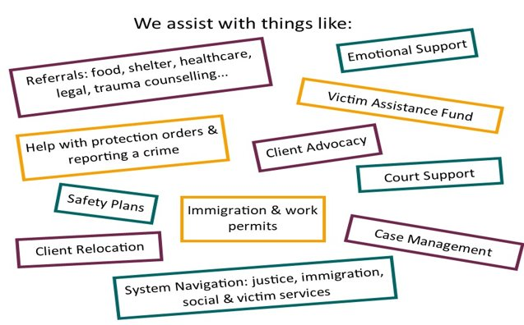
ACT Client Services
Notes:
Victim Assistance Fund can support:
Counselling ​
Basic needs or general poverty relief e.g gift cards for food, hygiene supplies.. ​
Transportation e.g. costs associated with relocation ​
Immigration e.g. IRCC application fees ​
Shelter e.g. hotel stay when alternatives for emergency shelter is not available ​
Health Care e.g. prescription costs or other fees for health care services if the person is ineligible for the Alberta Health Care Insurance Plan ​
Interpretation services ​
Legal assistance e.g. consultation fees for lawyers ​
Repatriation support e.g. support through International Social Services ​
Miscellaneous e.g. cell phone minutes or paying for identification documents

Slide 8
Strategic Engagement
Community Engagement
Data Collection
Research
Notes:
Based on community input,
Community Engagement - Connecting with diverse stakeholders to broaden the collaborative network and improve upon the services offered to trafficked individuals in Alberta
Data Collection – Gathering local data on sex and labour trafficking trends and the needs and gaps in services for their clients at risk of or experiencing trafficking
Research – Undertaking local research initiatives to enhance our collective knowledge on the landscape of human trafficking in Alberta
Based on community input we currently have a project specific to engaging with the LGBTQ2S+ and disability communities. At this stage we are learning from various organizations related to the needs and gaps in service for these specific communities.

Slide 9
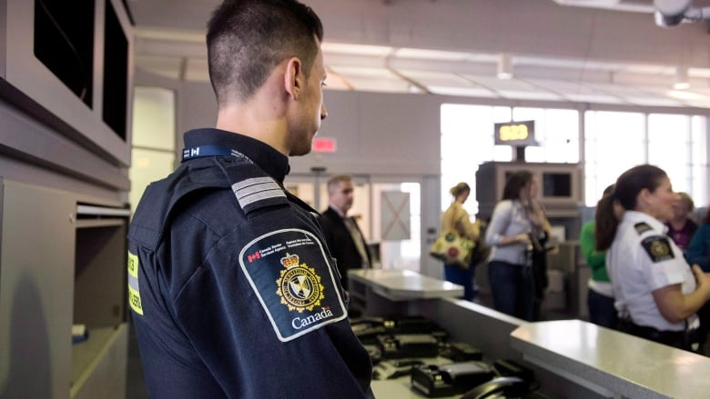
Training and Education
Increasing access to justice through training of enforcement officers
Incorporating a trauma-informed approach
Notes:
ACT Alberta has partnered with RCMP to deliver joint presentations for training CBSA officers at the Calgary international airport, related to raising awareness of human trafficking. To date, over 200 CBSA officers have been trained.
Results of the training, have included:
-Increasing awareness on labour trafficking. officers at every session have asked questions related to the identification of victims of labour trafficking, showing that addressing labour trafficking is increasingly on their radar.
-CBSA officers have said that they have started to flag some immigration lawyers and recruiters who have engaged in unethical practices
-Victims of trafficking for labour exploitation have been identified, where officers were able to recognize a labour trafficking situation as a direct result of the training
ACT has partnered with other organizations to co-deliver a full day training which goes beyond awareness raising, by incorporating information on a trauma-informed approach

Slide 10
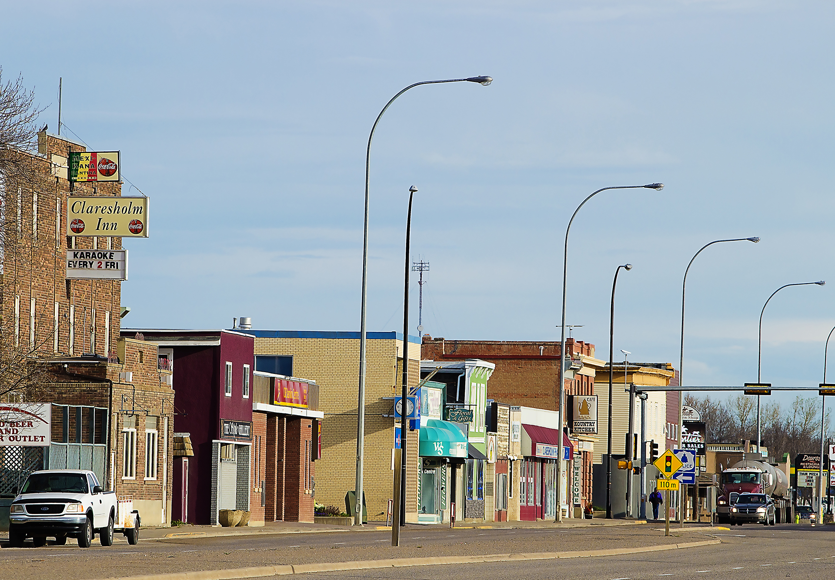
Awareness Raising
Rural Project
Community Capacity Response Map
Increasing collaboration
Notes:
Among the barriers to access to justice is lack of awareness of human trafficking and how to identify victims, as well as lack of services in areas outside of the large urban centres. ACT Alberta is now engaging in rural project
Through the provincial training program and by collaborating on cases, ACT has developed relationships with organizations throughout the province. In this way, stakeholders that are interested in increasing their capacity to respond to human trafficking have been identified.
ACT Alberta is working on the development of a Community Capacity Response Map Tool to be used by communities and organizations in non major urban and rural areas. The tool and supporting resources will facilitate access to effective resources in areas that do not have a strong, cohesive support network in place.
One of the issues identified in indigenous communities has been the significant support required as many of the survivors have just started seeking support based on the federal report that is seen as a validation for their suffering and grief. This issue has come up during discussions with stakeholders as many of the victims were trafficked from small and remote indigenous communities
As a result of meeting with representatives of the 5 Nations Communities in the Lesser Slave Lake area, ACT Alberta was invited by the Western Cree Tribal Council to provide training to residential school survivor support workers regarding human trafficking and trauma-informed care in relation to the MMIW report at the end of October.

Slide 11
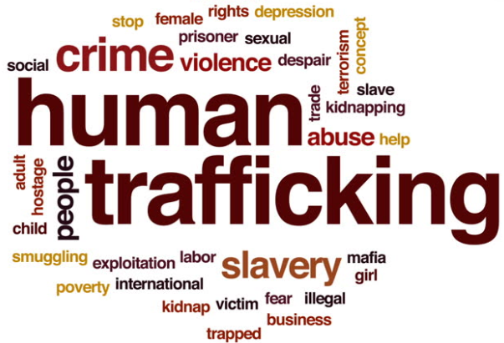
Responding to Human Trafficking
OWP for vulnerable workers
Provincial strategy
Collaboration with
broader initiatives
Notes:
ACT Alberta has assisted in successfully obtaining between 10-15 vulnerable OWPs since the inception in June. TFWAO has successfully assisted in around 30. For successful applications, the OWPs have been issued quickly, between 2-5 business days when they include strong supporting documents. They take more time where there are no supporting documents.
The provincial government has committed to Implementing an Alberta Action Plan to Combat Human Trafficking, which includes a nine point plan.
Currently, the government is in the process of creating a task force, Managed by AB Justice and Solicitor General. both the Ministry of Labour and Immigration and Multiculturalism, Culture & Status of Women have been asked to forward names for consideration by cabinet. GOA held a major meeting in August for all NGO's regarding the changes in legislation that are anticipated and input on the Task Force.
Main focus is legislation for the Spring session to enhance Tort Laws and victim abilities to obtain Protection Orders.
The Task Force and its goals are modeled on Ontario's recent task force.
One of the main goals will be to choose an annual "awareness" date, as well as other general considerations about raising awareness.
They will also work on the "universal" adoption of the Palermo Protocol as the framework.
We ensure that we participate and are engaged in broader initiatives, such as Sanctuary City Edmonton aimed at developing a network or support services for those with precarious status and those working to address gender-based violence.

Slide 12
Questions? @actalberta www.actalberta.org dianamrowka@actalberta.org info@actalberta.org 780-474-1104
Thank you!
Notes:
I have a question – If we are falling behind – then how TODAY are we going to find a made-in-Canada solution?

